Slide 1
Cyber Threat Intelligence Report: possibility of Lazarus Group Targeting Zenith Bank
Presented
By
CHIDUBEM JUDE ANYAEGBU

Slide 2
Executive Summary
What? The Lazarus Group, a North Korean state-sponsored threat actor, has been identified as a significant cyber threat to Zenith Bank, a leading financial institution in Nigeria.
So What? The group’s history of targeting financial institutions (e.g., Bangladesh Bank heist) and deploying sophisticated malware (e.g., WannaCry) indicates a high risk of data theft, financial loss, or ransomware attacks. Zenith Bank online banking infrastructure such www.zenithbank.com and customer data are prime targets.
What Now? Zenith Bank must enhance its cybersecurity posture by implementing proactive defenses, monitoring for specific tactics, techniques, and procedures (TTPs), and training staff to mitigate risks from phishing and social engineering attacks.
Threat Level: High, due to Lazarus Group’s advanced capabilities and focus on financial sectors.
Recommendation: Immediate implementation of multi-factor authentication (MFA), endpoint detection, and threat intelligence integration to counter potential attacks.

Slide 3
Threat Actor Profile
Name: Lazarus Group (aka Hidden Cobra, Guardians of Peace, ZINC, Diamond Sleet)
Origin: North Korea, attributed to the Reconnaissance General Bureau (RGB).
Motivation: Financial gain, espionage, geopolitical disruption.
actics: Phishing, watering hole attacks, exploitation of software vulnerabilities (e.g., Apache Struts 2), and strategic web compromises.
Targeting: Financial institutions, cryptocurrency exchanges, critical infrastructure, and government entities globally.
Key Characteristics:
Active since at least 2009, known for high-profile attacks (e.g., Sony Pictures 2014, WannaCry 2017, Bangladesh Bank 2016).
Operates subgroups like Bluenoroff (financial cyberattacks) and Andariel (South Korea-focused reconnaissance).
Uses advanced tools: DDoS botnets, keyloggers, remote access tools (RATs), wiper malware, theharvester and ransomware (e.g., WannaCry, AppleJeus).

Slide 4
Techniques Observed:
Passive Reconnaissance: Scraping ZenithBank.com for employee details, public APIs, and third-party vendor information with TheHarvester.
Active Reconnaissance: Scanning for vulnerabilities in web applications, network services, and outdated software (e.g., T1016: System Network Configuration Discovery).
Social Engineering: Targeting employees via LinkedIn and other platforms to identify key personnel for phishing campaigns.

Slide 5
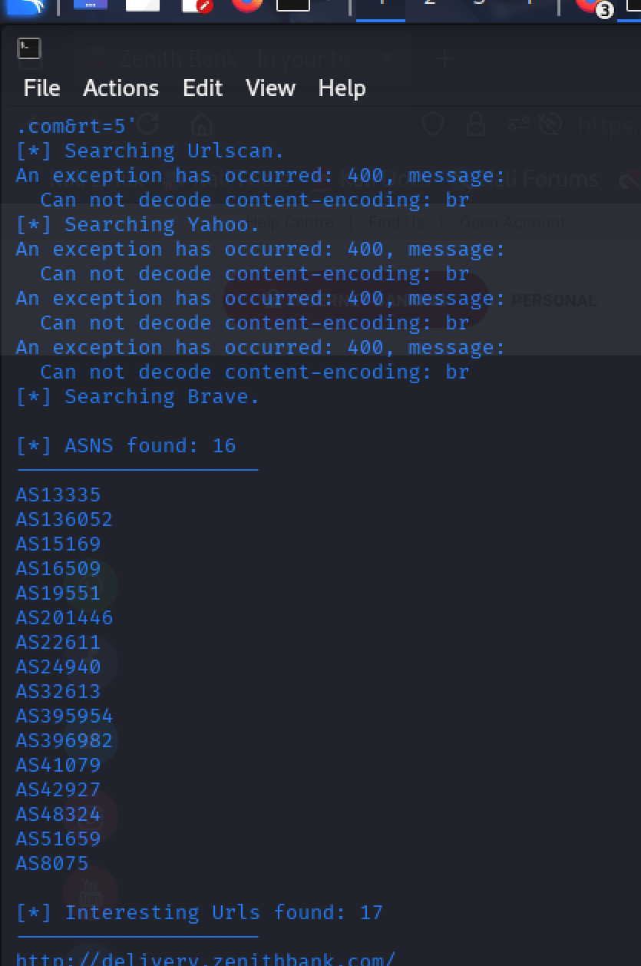
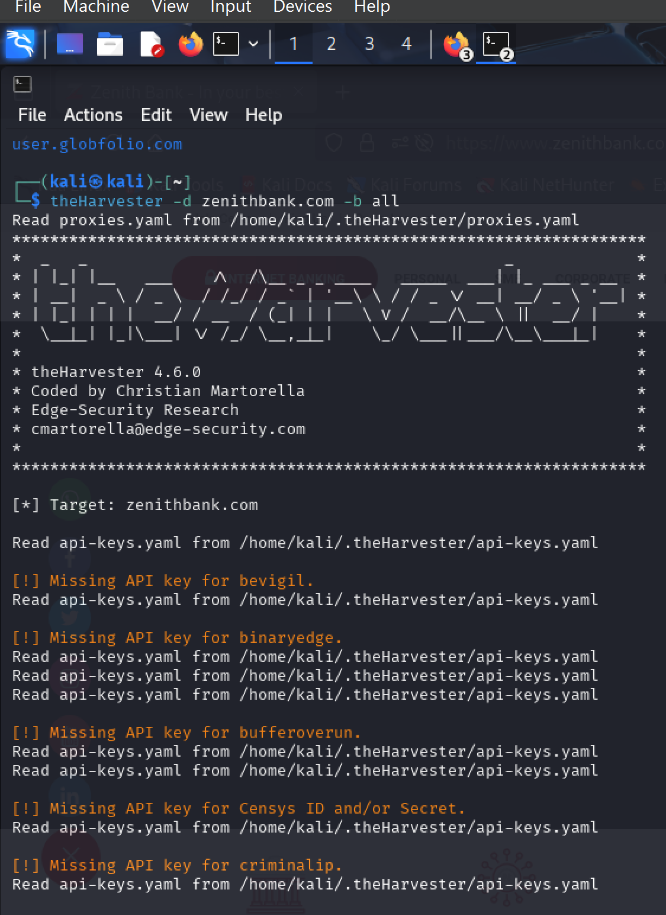
Reconnaissance
Findings:
Zenith Bank uses public-facing web servers that may run unpatched versions of software, increasing vulnerability to exploits.
Employee details available on public platforms could be leveraged for spear phishing.
Third-party vendors (e.g., payment processors) may serve as weak entry points.

Slide 6
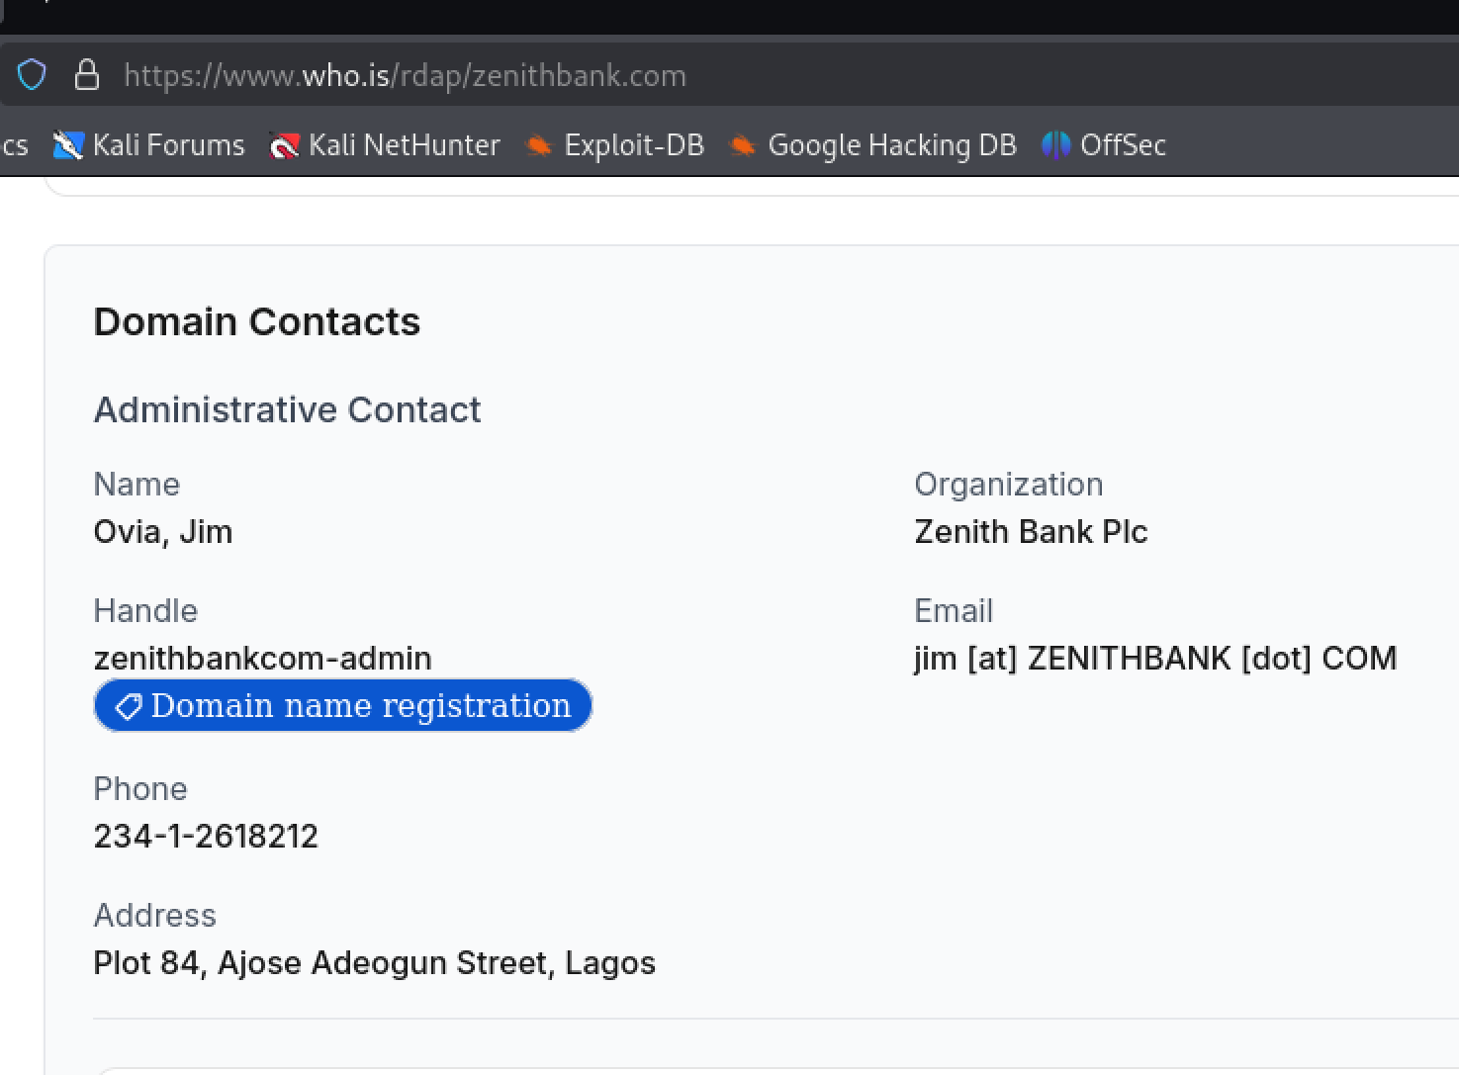
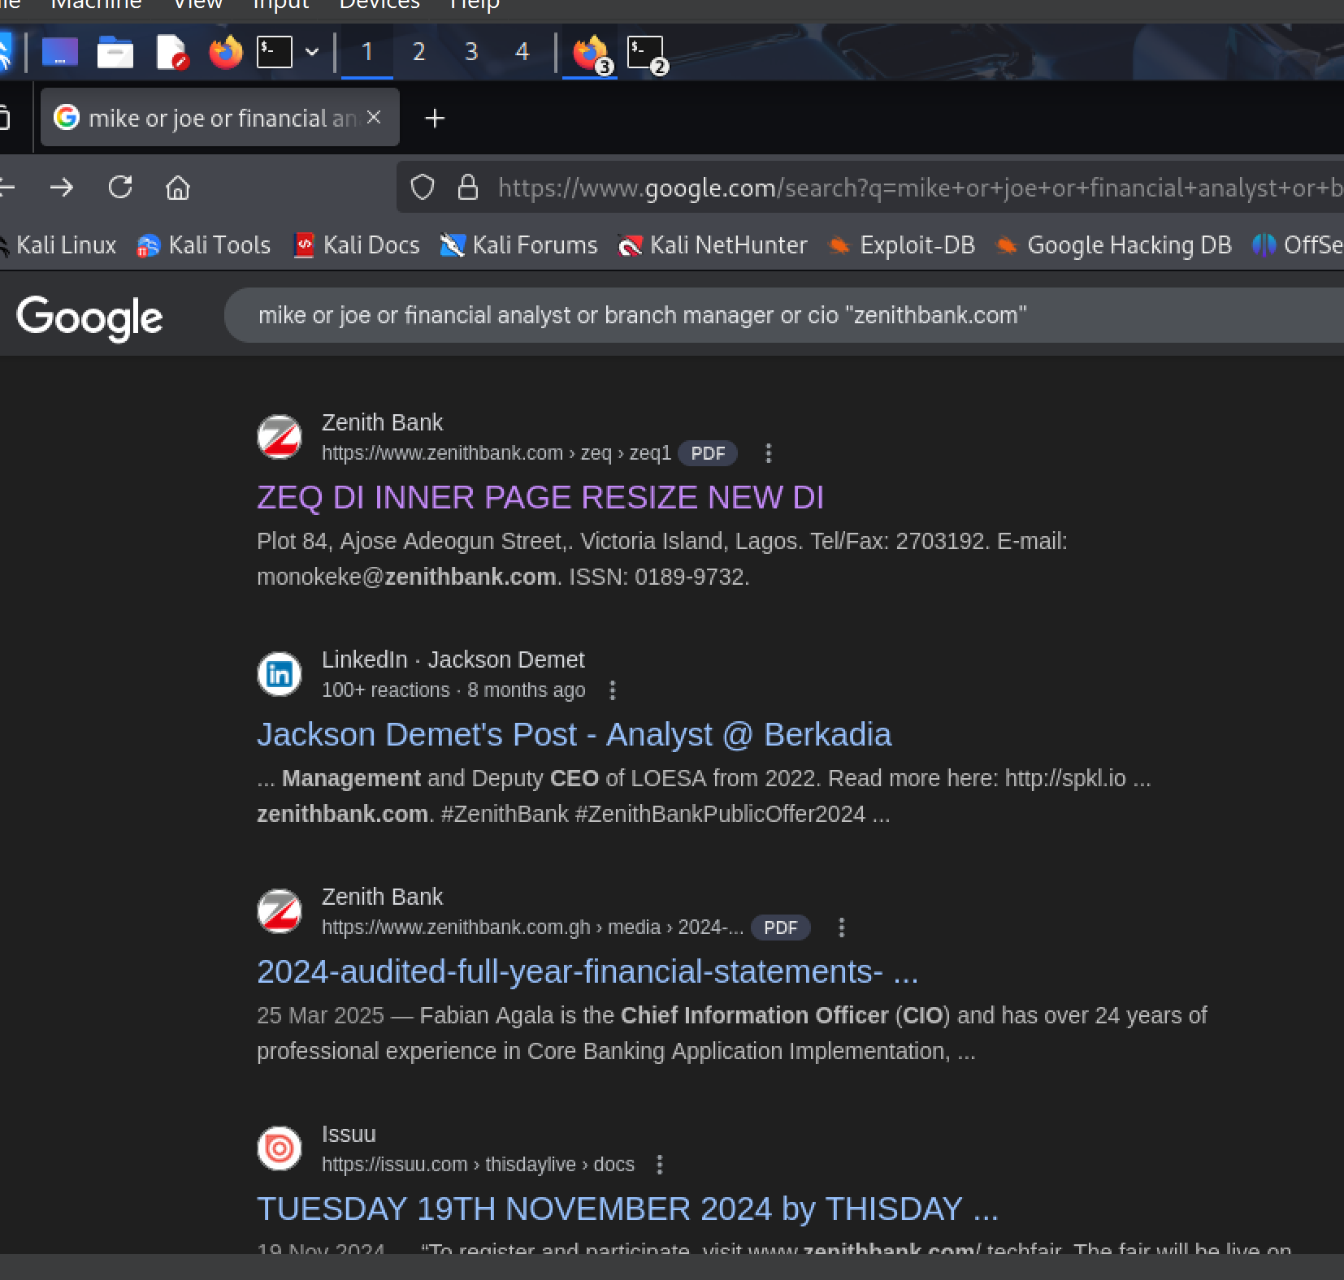
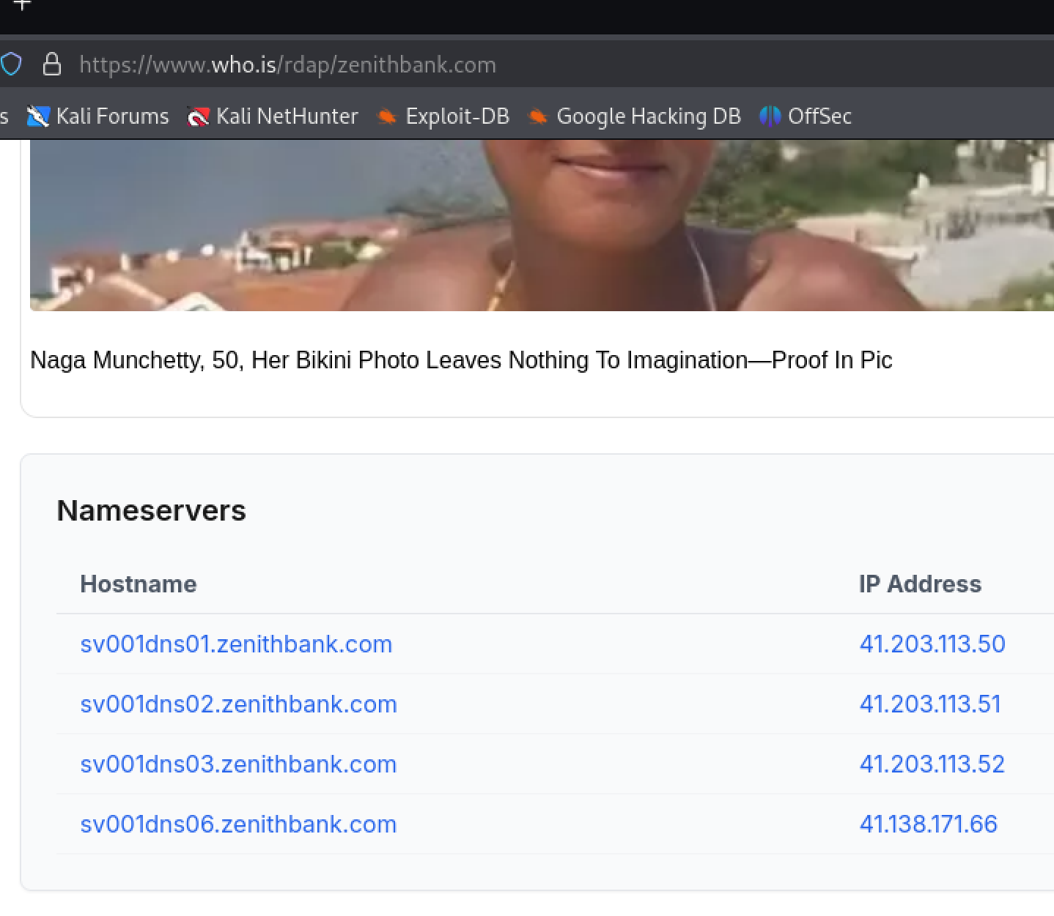
Continue TheHarvester, Whois and Google Docking

Slide 7
Attack Simulation Steps
Lazarus Group may executes a multi-stage attack to steal funds and sensitive data from ZenithBank.com.
Initial Access (Phishing):
Spearphishing emails targeting bank employees with malicious attachments or harvesting the website (T1566.001).
Execution:
Deployment of a remote access tool (RAT) like Dacls or Bankshot to establish a foothold (T1059: Command and Scripting Interpreter).
Persistence:
Creation of scheduled tasks (T1053) or registry run keys (T1547.001) to maintain access.

Slide 8
Continue Attack Steps
Privilege Escalation:
Exploitation of unpatched vulnerabilities (e.g., CVE-2021-44228 in Apache Log4j) to gain elevated privileges (T1068).
Lateral Movement:
Use of stolen credentials to move across the network (T1078: Valid Accounts).
Data Exfiltration:
Collection of customer data and financial records (T1005: Data from Local System), exfiltrated via encrypted channels (T1041).
Impact:
Deployment of ransomware (e.g., WannaCry) or wiper malware to disrupt operations (T1486: Data Encrypted for Impact).

Slide 9
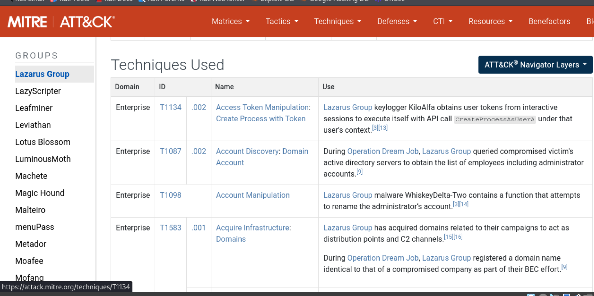
MITRE ATTA&CK Table Screen shot

Slide 10
Potential Impact
Financial Loss:
Direct theft of funds via SWIFT network manipulation (e.g., $101M stolen in Bangladesh Bank heist).
Cost of ransomware payments or recovery from wiper attacks.
Operational Disruption:
Downtime of online banking services due to ransomware or DDoS attacks, impacting customer trust.
Data Breach:
Exposure of customer PII, leading to regulatory fines (e.g., under Nigeria Data Protection Regulation) and reputational damage.

Slide 11
Continue Potential Impact
Geopolitical Implications:
As a North Korean state-sponsored actor, Lazarus Group’s actions could escalate tensions or draw international scrutiny.
Supply Chain Risk:
Compromise of third-party vendors could amplify attack impact, affecting interconnected financial systems.

Slide 12
Recommendations
Enhance Detection Capabilities:
Deploy endpoint detection and response (EDR) tools to monitor for TTPs like T1059.001 and T1078.
Integrate threat intelligence feeds to identify Lazarus Group IOCs (e.g., known C2 IPs).
Strengthen Access Controls:
Enforce MFA across all accounts and systems to prevent credential abuse.
Disable unused accounts and implement strong password policies.
Patch Management:
Regularly update software to mitigate vulnerabilities (e.g., Apache Struts, Log4j).

Slide 13
Continue Recommendation
Employee Training:
Conduct phishing awareness training to recognize spear phishing attempts.
Network Segmentation:
Isolate critical systems (e.g., SWIFT servers) from external networks to limit lateral movement.
Incident Response Planning:
Develop and test an incident response plan tailored to ransomware and data exfiltration scenarios.
Engage a third-party incident response team (e.g., Unit 42) for proactive assessments.
Third-Party Risk Management:
Audit vendors for cybersecurity compliance to reduce supply chain risks.

Slide 14
THANKS FOR YOUR TIME
THE END

